Slide 1
Chapter 14
Resolution in the
Propositional Calculus

Slide 2
Overview
  2. Knowledge Representation and Reasoning
    2.2 Resolution in Propositional Calculus

Slide 3
14 Resolution in Prop Cal
Resolution inference rule
Conversion to CNF
Refutations
Refutation Search Strategies
Horn Clauses

Slide 4
4.1 Resolution rule
Combination of earlier rules
  applied to clauses
Clause
  disjunction of literals
  alternatively: set of literals
  special case: empty clause (False)

Slide 5
Resolution of clauses
From
  C1 = {λ} ∪ Σ1 and C2 = {¬λ} ∪ Σ2
infer
  C = Σ1 ∪ Σ2
  C is a resolvent of C1 and C2
  λ: atom resolved upon

Slide 6
Soundness
If {λ} ∪ Σ1 & {¬λ} ∪ Σ2 are true
then Σ1 ∪ Σ2 is, too
How?
  λ is either true or false
  true: Σ2 must be true
  false: Σ1 must be true
  → whatever the value, Σ1 ∪ Σ2 is true
  can also be shown with truth table

Slide 7
14.2 Conversion to CNF
Aim
  take any wff
  convert it to conjunction of clauses
  in order to use resolution inference
How?
  eliminate implications
  push negations in (DeM, elimination)
  use assoc & distrib laws

Slide 8
Procedure for step 3
Write DNF wffs as a matrix
  rows: literals of each conjunct
  select a literal in each row
  make a disjunction (clause) of these
  make all possible selections
  result: conjunction of these
Simplifications
  absorption, P v ¬P
  Subsumption: keep the `strongest’ one

Slide 9
14.3 Resolution refutations
Resolution: sound, not complete
  P ∧ R |= P ∨ R
What we can show, is that
  negation of P ∨ R (¬P ∧ ¬R) is inconsistent with P ∧ R
  and thus (by contradiction) that P ∧ R |= P ∨ R

Slide 10
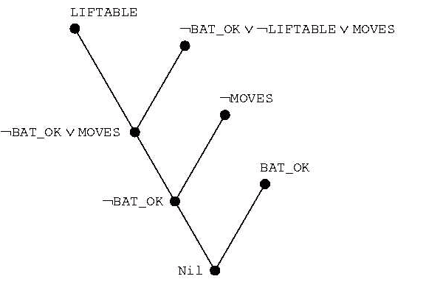
Resolution Refutation
Tree

Slide 11
General procedure
Aim: show that Δ |= ω
  convert Δ to set of clauses
  convert ¬ ω to clause form
  combine the above to a single set Γ
  apply (iteratively) resolution to Γ
    add results to Γ
    until an empty clause is produced
    or Γ does not change any more

Slide 12
Known results
Completeness of resolution
  if Δ |= ω then
  resolution refutatation will (eventually) produce the empty clause
  resolution is refutation complete
Decidability of Prop Calc
  if Δ is finite and not Δ |= ω then
  refutation procedure terminates without producing the empty clause

Slide 13
14.4 Search strategies
How to efficiently
  perform resolutions until empty clause is inferred
  not all possible resolutions are essential in deriving the empty clause
Ordering strategies
  which clauses should be used = ’which node to expand next’
  terminology
    original clauses: 0th level resolvents
    (i + 1)th level: resolvent of ith & jth (j < i)

Slide 14
14.4.1 Ordering…
Breadth-first strategy
  work level by level
Depth-first
  clause with highest level (with choices left)
Unit preference
  prefer clauses consisting of a single literal
  only these make the resulting clauses shorter

Slide 15
14.4.2 Refinement strategies
Only certain resolutions allowed
  don’t say anything about ordering
  some complete, some not
Set of support
  C2 is a descendant clause of C1 if C2 is a resolvent of either
    C1 and some other clause
    a descendant of C1 and some other clause
  strategy
    Let S = ¬ ω and it’s descendants
    choose other clause always from S
    complete!

Slide 16
Refinement strategies...
Linear Input (aka linear resolution)
  at least one clause is from the original set
  not refutation complete
Ancestry filtering: one clause is
  either member of the original set
  or ancestor of the other clause
  refutation complete

Slide 17
14.5 Horn Clauses
Special type of a clause
  at most one positive literal
Three types
  facts (single atoms)
  rules (one pos, m > 0 neg)
  queries, goals (all neg)

